Slide 1





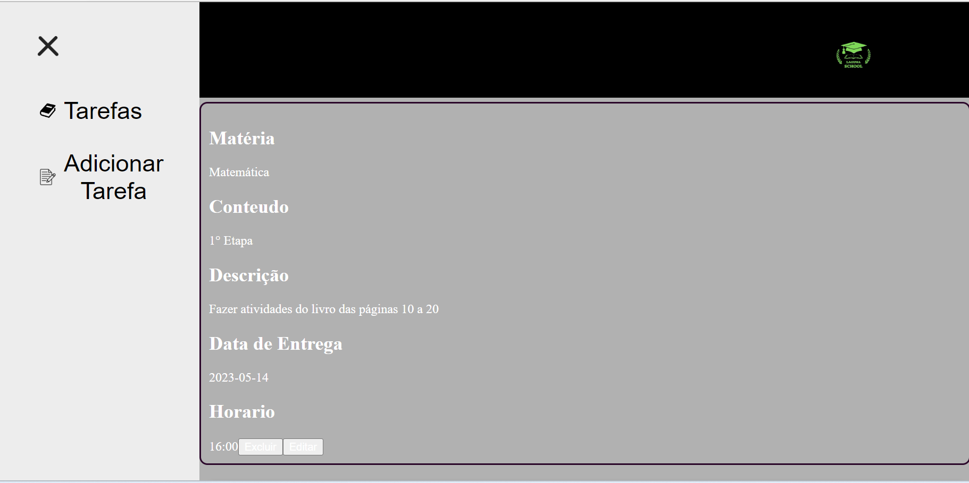
Web page title
Laguna School

Slide 2
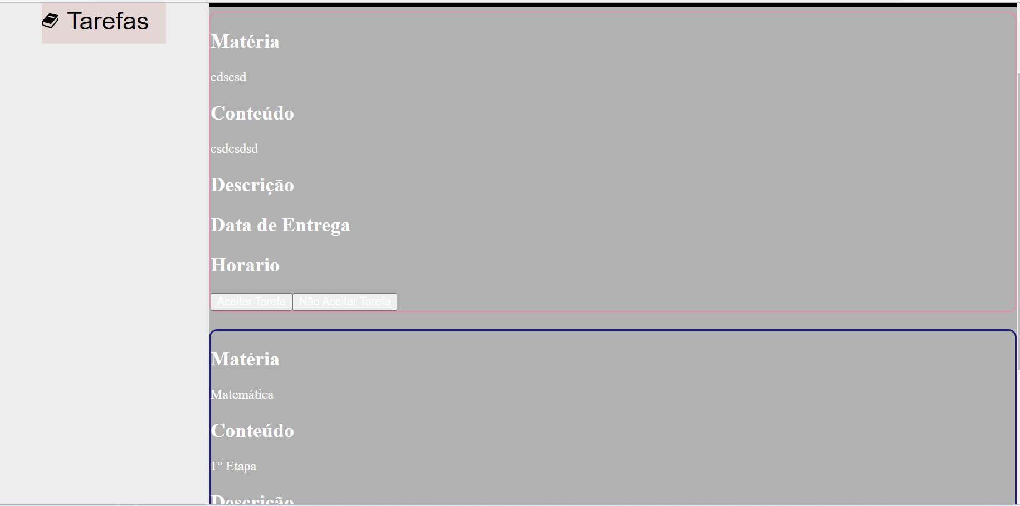
Web page title
Laguna School

